Slide 1


SPRING VALLEY VILLAGE POLICE DEPARTMENT
MONTHLY NEWSLETTER:
MARCH 2024
1025 CAMPBELL ROAD
HOUSTON, TX 77055
PHONE: 713-465-8323
COMMUNITY MATTERS.
WE ARE A TEAM.

Slide 2

INTRODUCTION
Hilshire Village Residents,
Here are some tips for our residents when calling 911. If you are calling from a landline phone your call is automatically routed to Spring Valley Village Police Dept. If you are calling from a cell phone, however, it may be routed to Houston Police Dept. based on the nearest cell tower. If this happens, simply ask to be transferred to Spring Valley Village Police Dept. Additionally, we suggest you save our non-emergency number (713-465-8323) as a contact in your phone to ensure you can always reach us.
Sincerely,
Chief M. Schulze
1025 CAMPBELL ROAD, HOUSTON, TX 77055
PHONE: 713-465-8323 / EMAIL: DISPATCH@SPRINGVALLEYTX.COM

Slide 3




MARCH 2024
DATE | DAY | SPECIAL DAYS FOR THIS MONTH
03-10-2024 | SUNDAY | DAYLIGHT SAVINGS TIME BEGINS
03-11-2024 | MONDAY | SBISD SPRING BREAK BEGINS
03-15-2024 | FRIDAY | SBISD SPRING BREAK ENDS
03-17-2024 | SUNDAY | ST. PATRICK’S DAY
03-19-2024 | TUESDAY | FIRST DAY OF SPRING
03-31-2024 | SUNDAY | EASTER
COMMUNITY MATTERS.
WE ARE A TEAM.
1025 CAMPBELL ROAD, HOUSTON, TX 77055 / PHONE: 713-465-8323 / EMAIL: DISPATCH@SPRINGVALLEYTX.COM

Slide 4


Public Service Announcement From Our Dispatchers:
Help 9-1-1 Help Y ou
Every second counts in an emergency. Don’t hesitate to contact 9-1-1 first during an emergency for police, fire, or medical assistance.
Get to a safe location before calling. If you are calling to report a fire, exit the burning building before calling.
Stay calm and answer all questions about your emergency.
State what help you need: police, fire, or EMS/medical.
State your address, describe your location as completely as possible using cross streets or landmarks.
Stay on the line — do not hang up until the operator says it’s OK.
COMMUNITY MATTERS.
WE ARE A TEAM.
1025 CAMPBELL ROAD, HOUSTON, TX 77055
PHONE: 713-465-8323 / EMAIL: DISPATCH@SPRINGVALLEYTX.COM

Slide 5
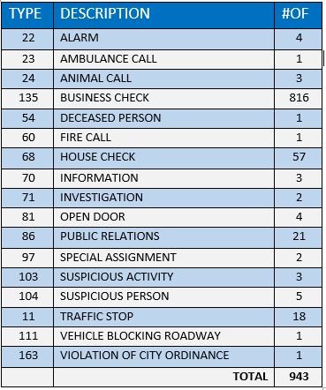
SPRING VALLEY POLICE DEPARTMENT
HILSHIRE VILLAGE
CALLS BY TYPE: 02-01-2024 THRU 02-29-2024
COMMUNITY MATTERS.
WE ARE A TEAM.
1025 CAMPBELL ROAD, HOUSTON, TX 77055
PHONE: 713-465-8323 / EMAIL: DISPATCH@SPRINGVALLEYTX.COM

Slide 6

1025 CAMPBELL ROAD, HOUSTON, TX 77055
PHONE: 713-465-8323 / EMAIL: DISPATCH@SPRINGVALLEYTX.COM

Slide 7
IMPORTANT NUMBERS
EMERGENCY |  | NON - EMERGENCY
911 - FOR ALL EMERGENCY |  | 713-465-8323
988 – NATIONAL SUICIDE & MENTAL HEALTH
SPRING VALLEY VILLAGE |  | VILLAGE FIRE DEPARTMENT
SPRING VALLEY - CITY HALL | 713-465-8308 | VILLAGE FIRE DEPARTMENT |  | 713-465-2323
SPRING VALLEY - PD | 713-465-8323 | VFD - NON-EMERGENCY |  | 713-468-7941
SPRING VALLEY - PD FAX | 713-465-3135
SPRING VALLEY - COURT | 713-465-0333
HILSHIRE VILLAGE
HILSHIRE VILLAGE – CITY HALL | 713-973-1779
COMMUNITY MATTERS.
WE ARE A TEAM.
1025 CAMPBELL ROAD, HOUSTON, TX 77055 / PHONE: 713-465-8323 / EMAIL: DISPATCH@SPRINGVALLEYTX.COM

